Slide 1



Making Every Contact Count (MECC) in Mental Health Settings
Sample images. To change picture, right click > Change Picture > From File
Name of presenter
Job title of presenter
Date

Slide 2
What is Making Every Contact Count (MECC)?
MECC is an approach to behaviour change that uses the millions of day-to-day interactions that organisations and people have with others to support them in making positive changes to their physical and mental health and wellbeing.
Drawing on behaviour change evidence, MECC maximises the opportunity within routine health and care interactions for a brief or very brief discussion on health or wellbeing factors.
https://www.nice.org.uk/Guidance/PH49

Slide 3

Benefits of MECC
MECC enables the opportunistic delivery of consistent and concise healthy lifestyle information and enables individuals to engage in conversations about their health at scale across organisations and populations.
A MECC interaction takes a matter of minutes and is not intended to add to the busy workloads of health, care and the wider workforce staff, rather it is structured to fit into and complement existing professional clinical, care and social engagement approaches.
Evidence suggests that the broad adoption of the MECC approach by people and organisations across health and care could potentially have a significant impact on the health of our population.

Slide 4
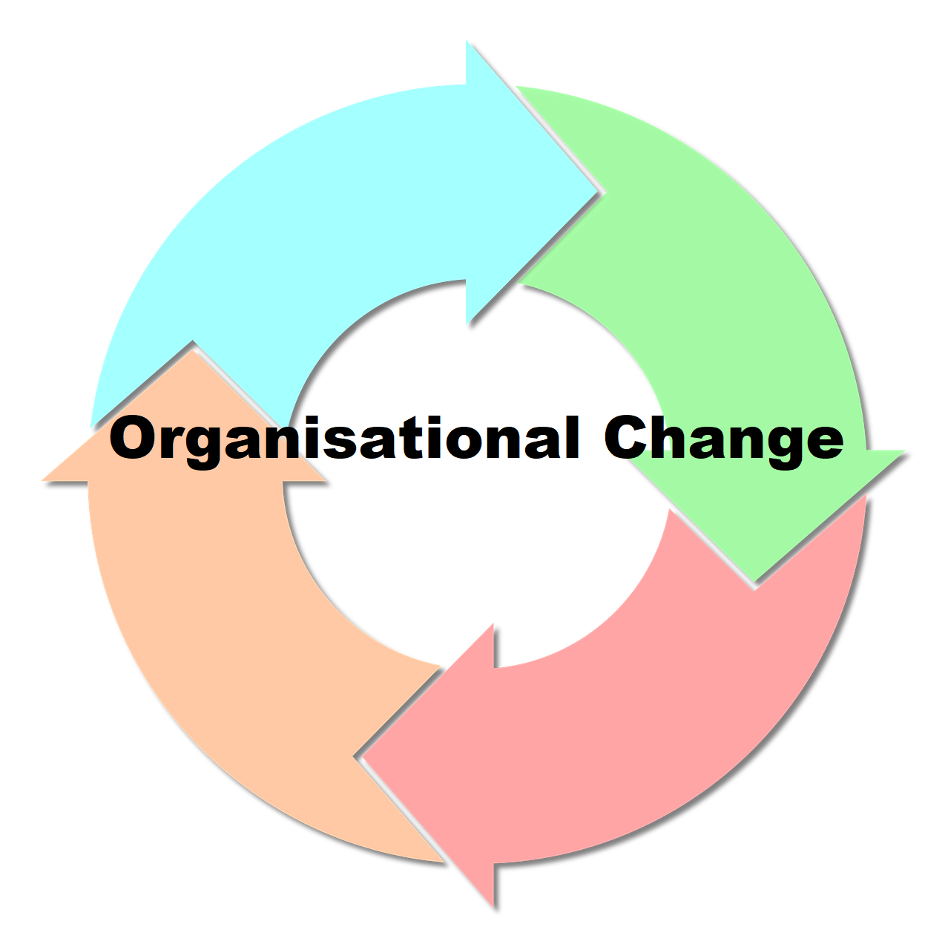
Managing Organisational Change
Organisations are complex systems
The influence of both internal and external factors means that organisational change and development is inevitable
When implementing a brief MECC intervention or a whole MECC programme you are creating change
Change needs to be managed in a systematic way to sustain long term change

Slide 5

How to lead change
Kotter’s 8-Step Process of Leading Change
Focuses on the people behind the change – in keeping with healthcare
Healthcare environments are centred around people and adopt a person-centred approach
NHS employees and patients are at the heart of its core values

Slide 6
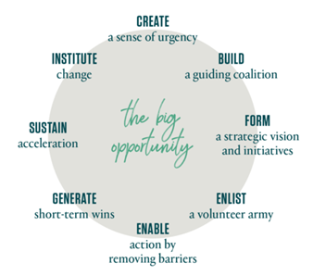
Kotter’s theory- phase one
Creating a climate for change
Creating a sense of urgency
Building a core coalition
Forming a strategic vision

Slide 7
Kotter’s theory- phase two
Engaging and enabling the whole organization
Getting everyone on board
Removing barriers and reducing friction
Generating short-term wins

Slide 8
Kotter’s theory- phase three
Implementing and sustaining change
Sustaining acceleration
Setting the changes in stone

Slide 9
MECC in mental health settings

Slide 10
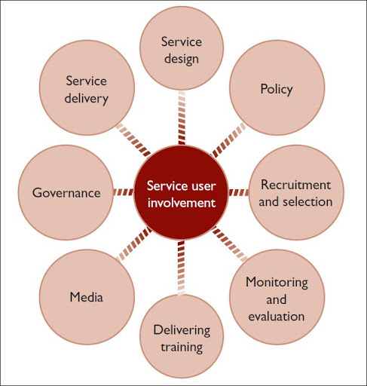

Two core concepts
Improve physical health in patients with severe mental illness (SMI)
Service user involvement

Slide 11

Improving physical health in patients with SMI
70% higher mortality rate compared to the general population & die 15-20 years earlier
Main causes of death:
  - cardiovascular disease
  - respiratory disease
  - diabetes
  - hypertension
Higher risk of poor physical health

Slide 12

Targeting unhealthy lifestyles
“It is health that is the real wealth”
40.5% of adults are smokers
Weight gain can be largely due to side effects of psychotropic medication
Obesity levels & risk of developing diabetes are more than double the general population
Increased experiences of social inequalities
Increasing hospital admissions relating to gambling addiction

Slide 13

Additional factors
High-risk sexual behaviour:
  - unprotected sex
  - multiple partners
  sex work (more common in some patients with SMI)
Comorbidity of drug use & mental illness increasing by 10% each year within England and Wales
86% of people using alcohol treatment services have a co-occurring mental health difficulties

Slide 14

Service user involvement
Benefits
Patients have more engagement in their own health, care and treatment
Patients become more involved in the design, planning and delivery of health services
Patients tend to report improved experience and satisfaction with care
Better relationships and trust between service users, healthcare professionals and the organisation

Slide 15

Quality marker checklist (QMC)
New additions to training
There are a number of unhealthy lifestyle behaviours that are highly prevalent in SMI population.
These include:
  - Debt and financial trouble
  - Gambling
  Sexual health & high risk behaviours
  Medication adherence & side effects
  - Self-harm & suicide prevention
  Substance misuse (drugs) including Novel
  Psychoactive Substances (NPS)

Slide 16

New topics to consider
Other optional topics have also been identified which can be incorporated into training depending on local needs:
  - Basic self-care practices
  - Oral health
  - Effects of trauma on mental illness
  - Social support network
  - Relapse
  - Crisis services
  - Inequalities
  - Housing & employment
  - Sleep

Slide 17
QMC and Kotter’s theory
Including Kotter’s theory
The key principles of Kotter’s organisational change to help increase uptake of MECC
Making staff aware of strategic plans and the progress of MECC will help staff understand the role they play in implementing it

Slide 18

Quality marker checklist
Service user involvement
The importance of co-production and co-delivery of training with service users and people with lived experience
Ensuring that this process follows guidance and core principles of engagement and inclusion

Slide 19

Increasing uptake of MECC
Key summary
Staff may feel that this is an addition to their already heavy workload
Important to frame MECC as something that staff already do and something that improves care and reduces workload.
For example: Structuring a greeting or ending of an appointment around a relevant topic of health behaviour

Slide 20




Practical Resources
MECC resources
MECC Consensus Statement (refreshed)
Implementation Guide
Training Quality Marker Checklist
Evaluation Framework

Slide 21
Thank you

